Slide 1
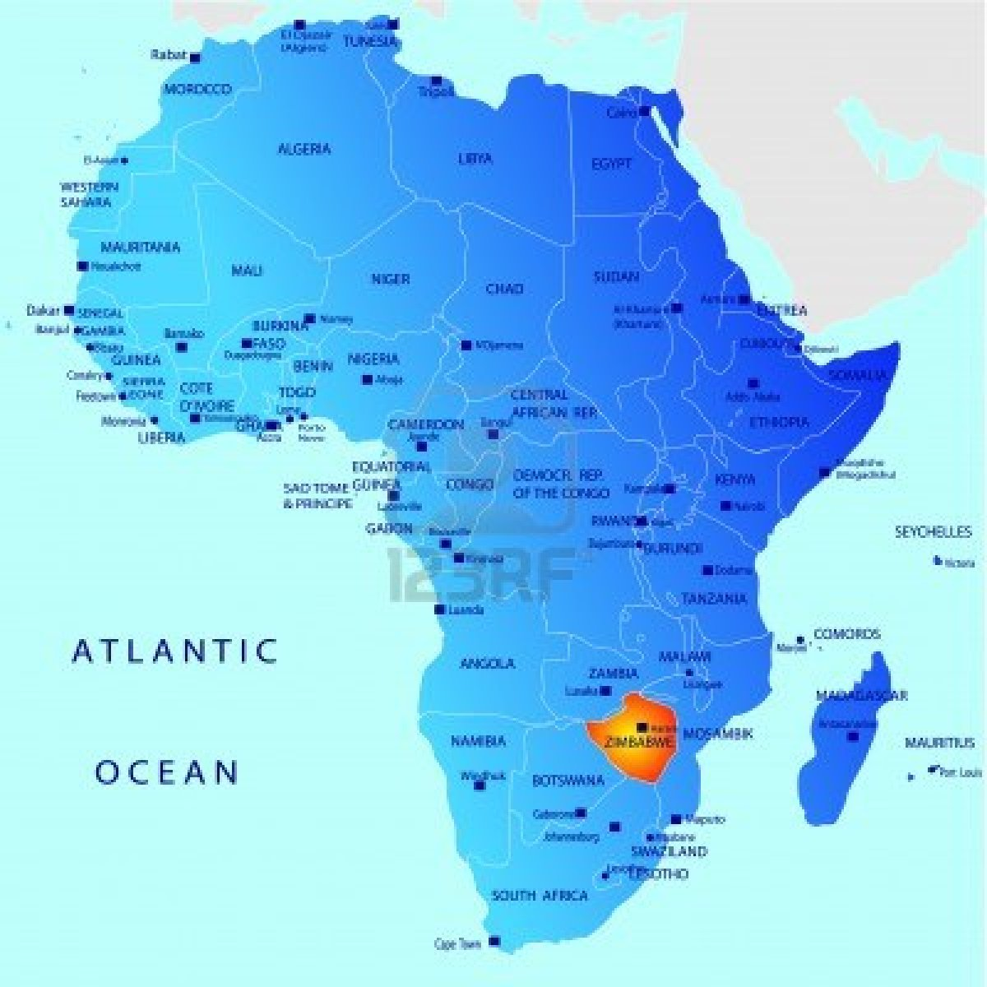
Fr Lameck’s work in Hera 2023

Slide 2
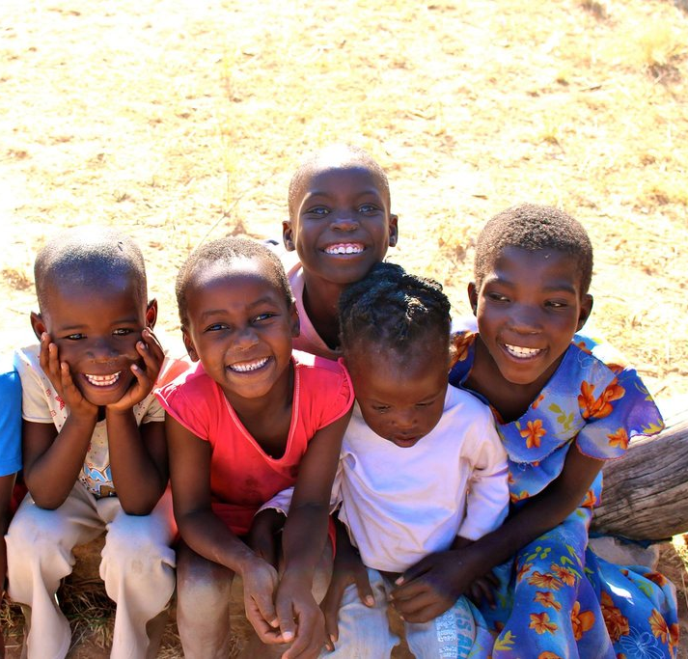
Building an Early Learning Centre
The village desperately needed a Nursery Unit to help the children aged 3-5years be looked after and provided for.
An early start to learning and early care for the youngest children, helps to ensure a brighter future.

Slide 3
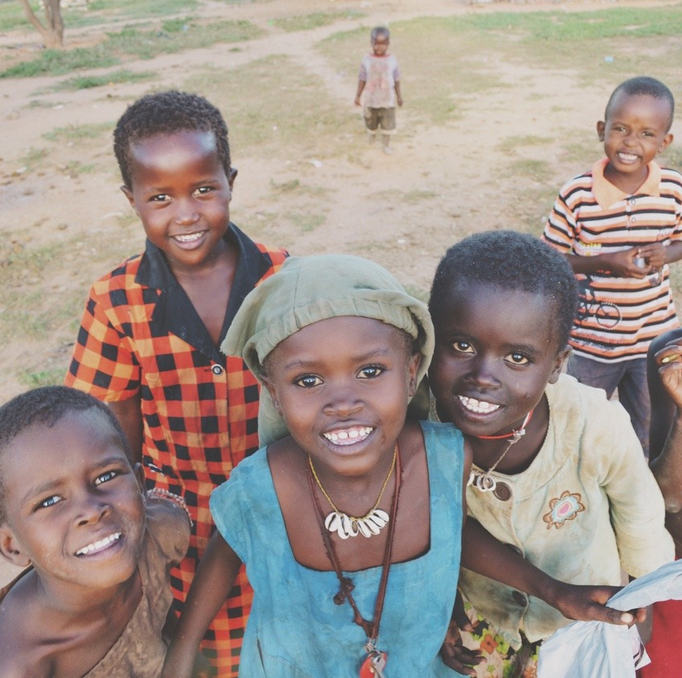
Building the Unit
Financial support from St Alban’s Advent Appeal last year, and a generous donation from a parishioner as well as further funding from Fr Lameck and family have made this happen.

Slide 4
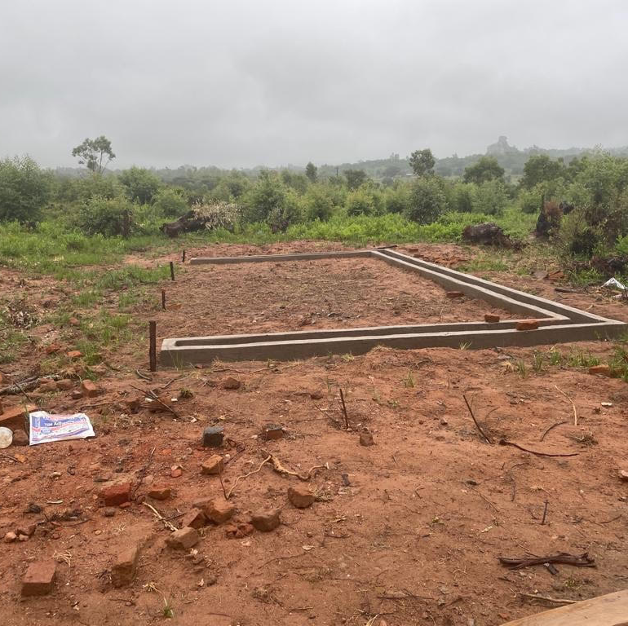
Building Progress…
The first step was to acquire the land and begin the foundations.

Slide 5
Building work underway….

Slide 6
The roof is on!

Slide 7
Windows installed and flower beds taking shape.

Slide 8
Toilet and Shower block under construction

Slide 9
Play area and landscaping

Slide 10
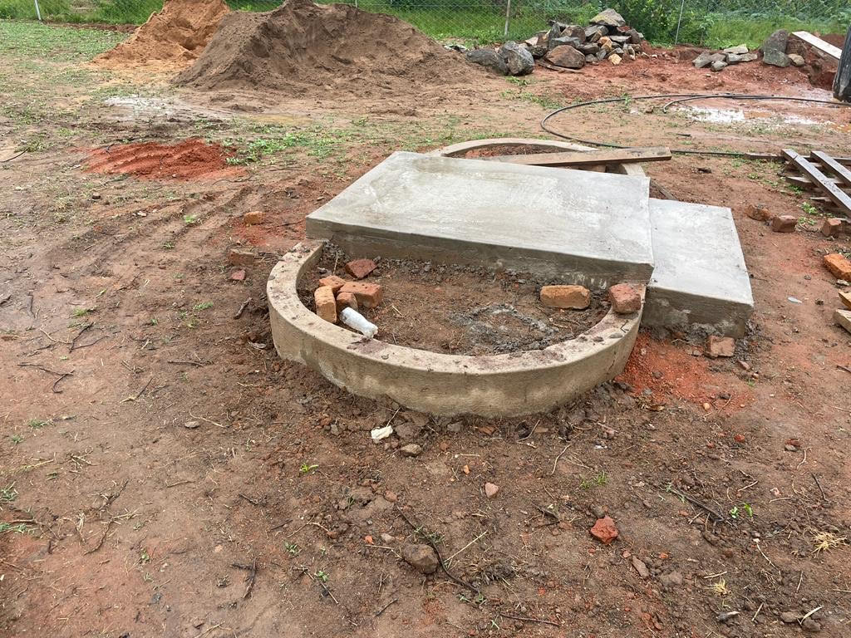
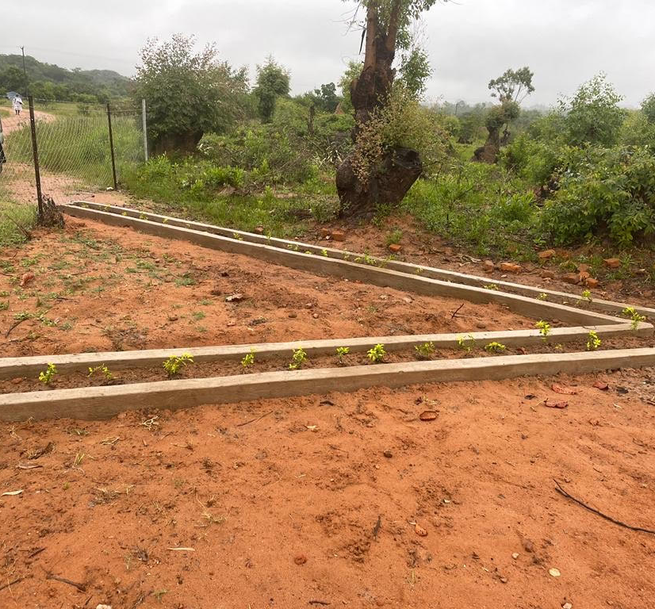
Foundations continue to be built

Slide 11
Father Lameck visiting the site and talking to the building Inspectors.

Slide 12
Inspection in progress…

Slide 13
Hera residents waiting to hear if the building has passed inspection…

Slide 14
Fr Lameck delivers the news that The Inspectors are very pleased with progress!

Slide 15
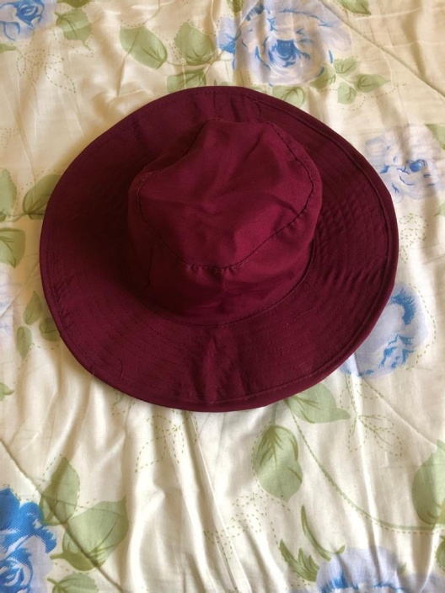
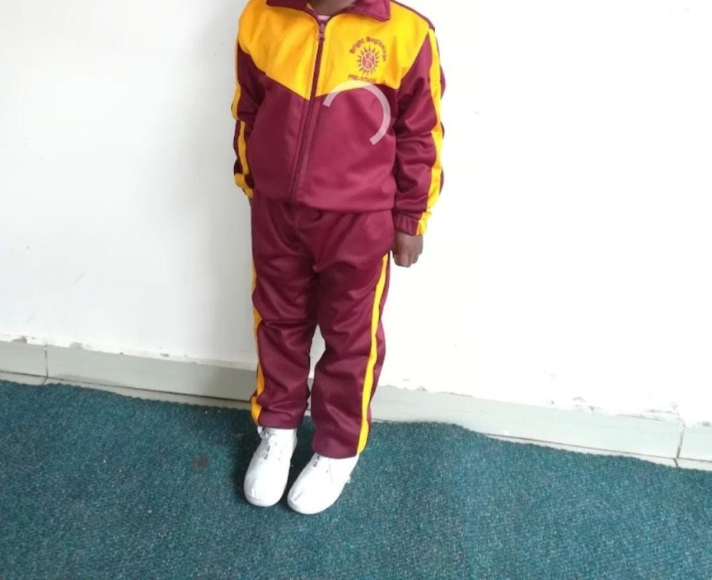
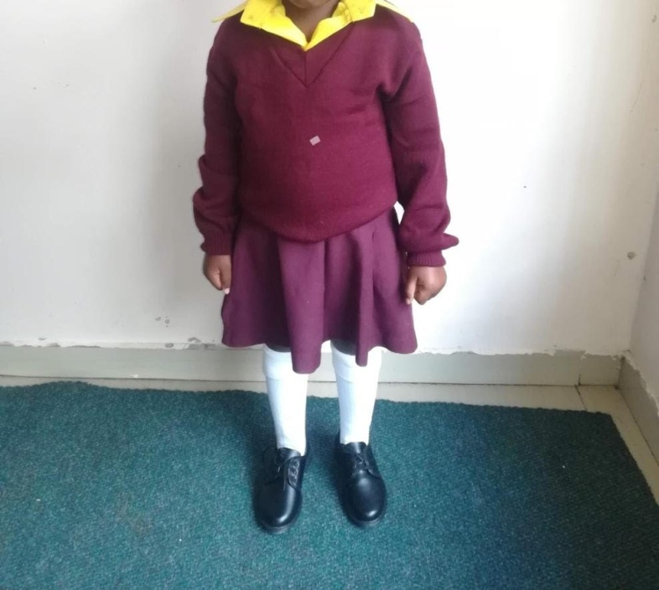
Now to buy uniform and start to register the children for enrolment

Slide 16
First day fun in new uniforms

Slide 17
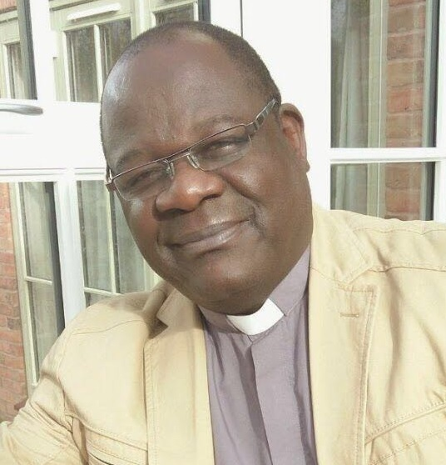
Final Report from Fr Lameck
“The education and building Inspectors were impressed with what has been achieved. We still require paint for the entire building, ceiling, solar system (electrics are in place), toys and teaching equipment and a water tank as a reservoir for the school supplies.
We are trusting in God and have begun registering children. My son is funding the first 10 children and we have a teacher and an assistant in place to run the school.
Thank you”

Slide 18
Distributing donations from Tattenhall to the girls

Slide 19
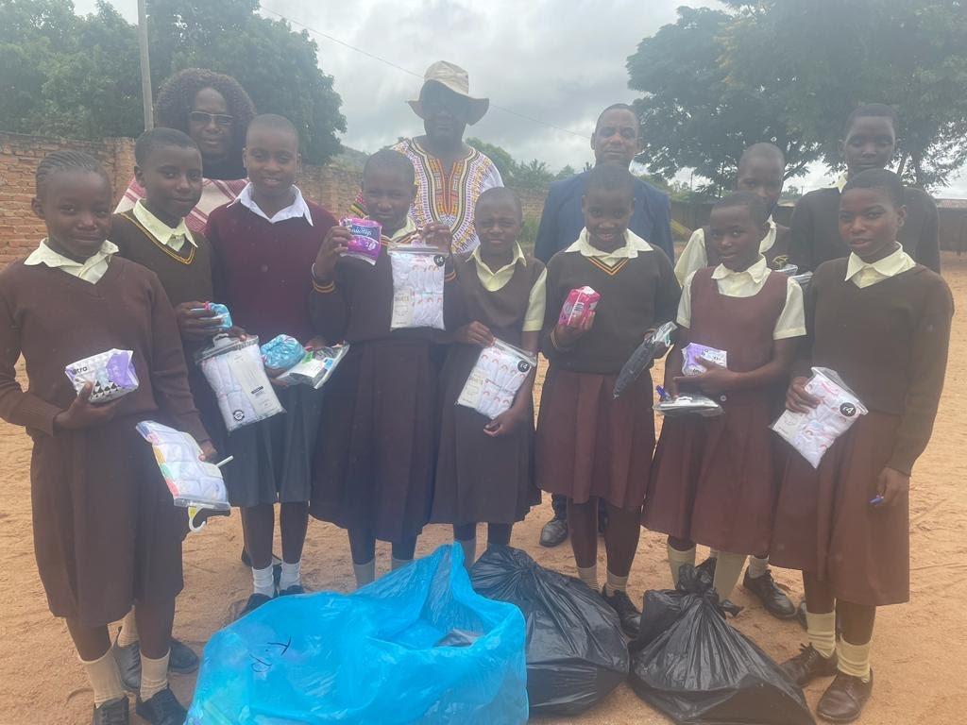
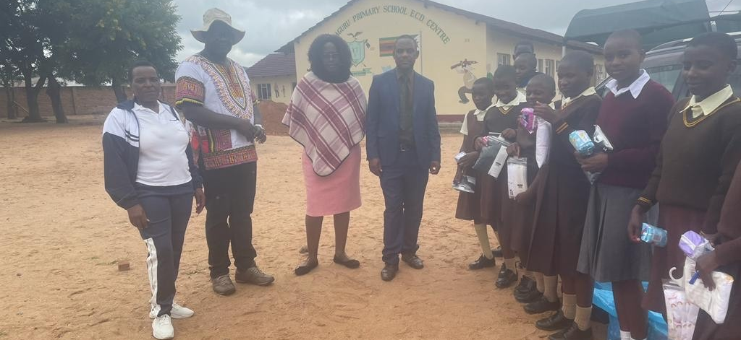
Fr Lameck and his wife, Pepetua, helping with the distribution.

Slide 20
St David’s primary school saying thank you to Fr Lameck for the stationery equipment which is already in use.

Slide 21
2024 Progress

Slide 23
2025 Update

Slide 24
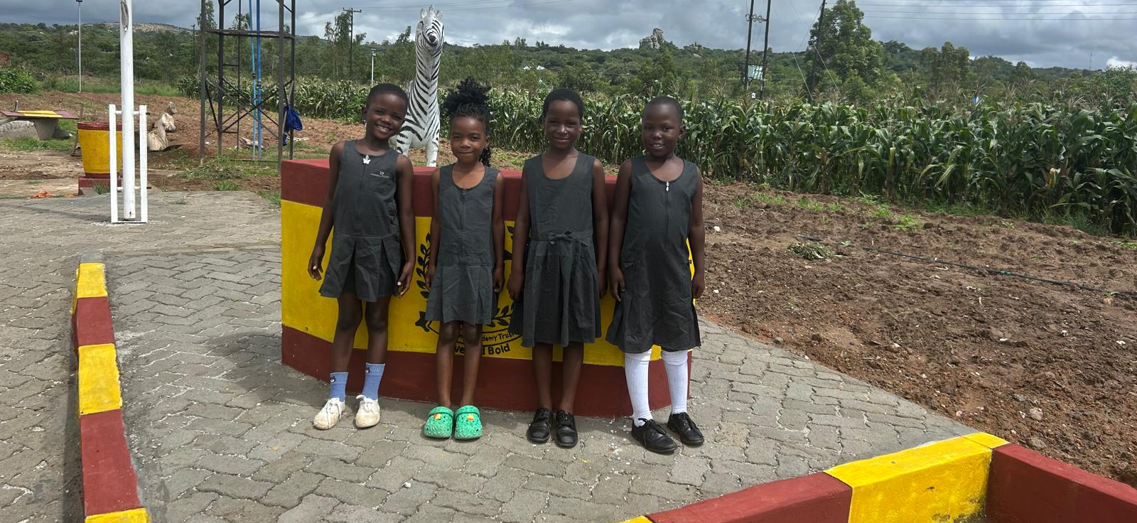
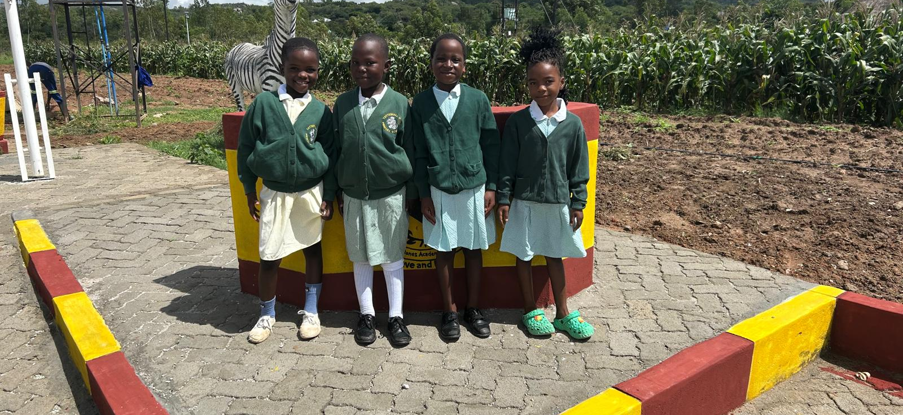
Thank you to Tattenhall Primary School for donating uniform
The pupils of Hera are proud to be wearing Tattenhall.

Slide 25
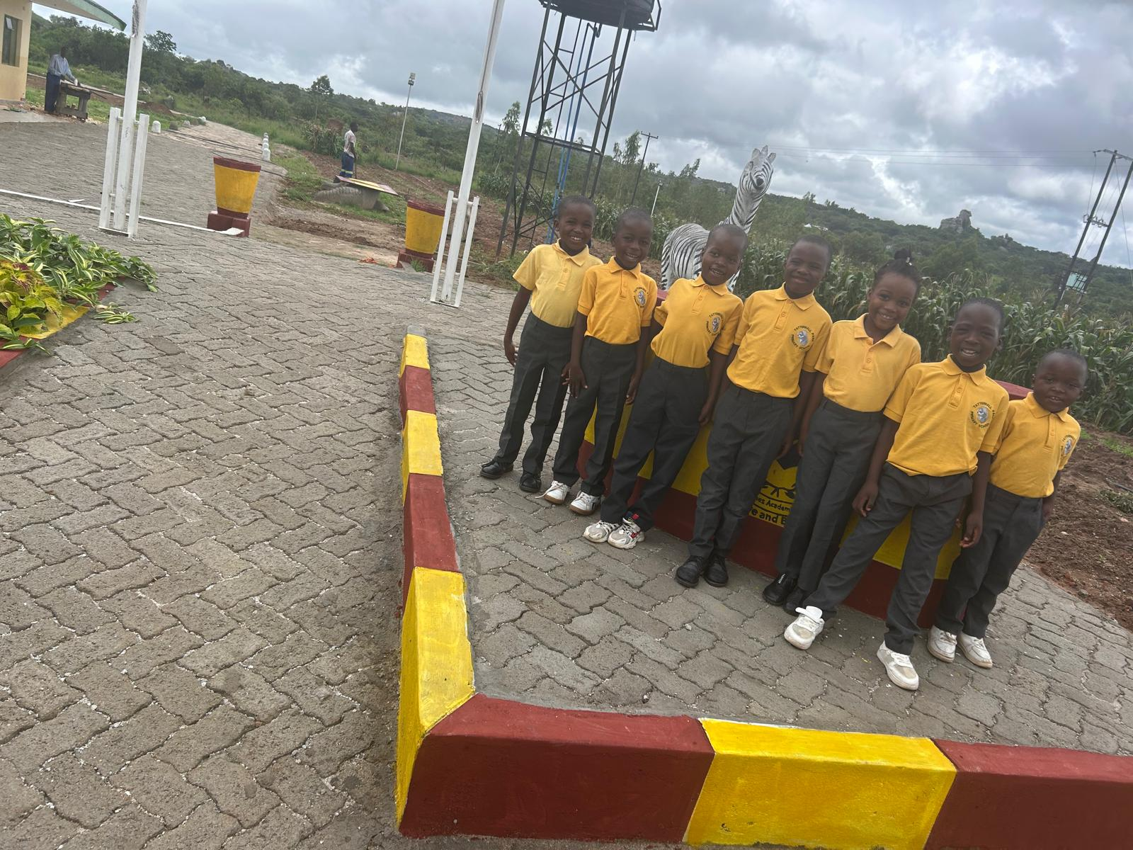
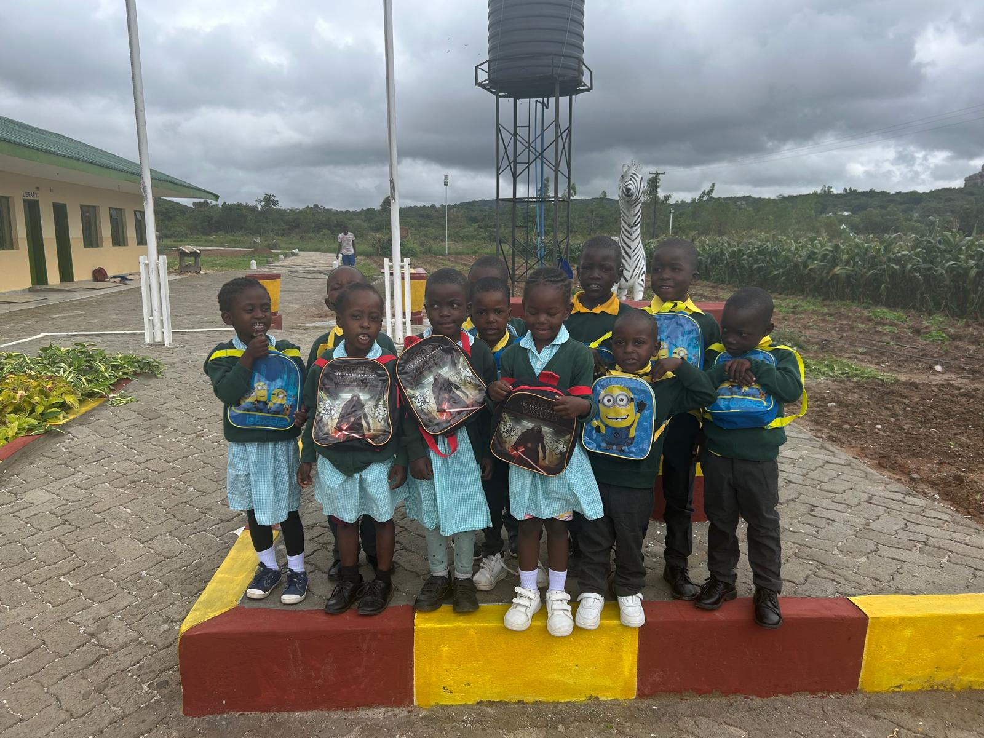
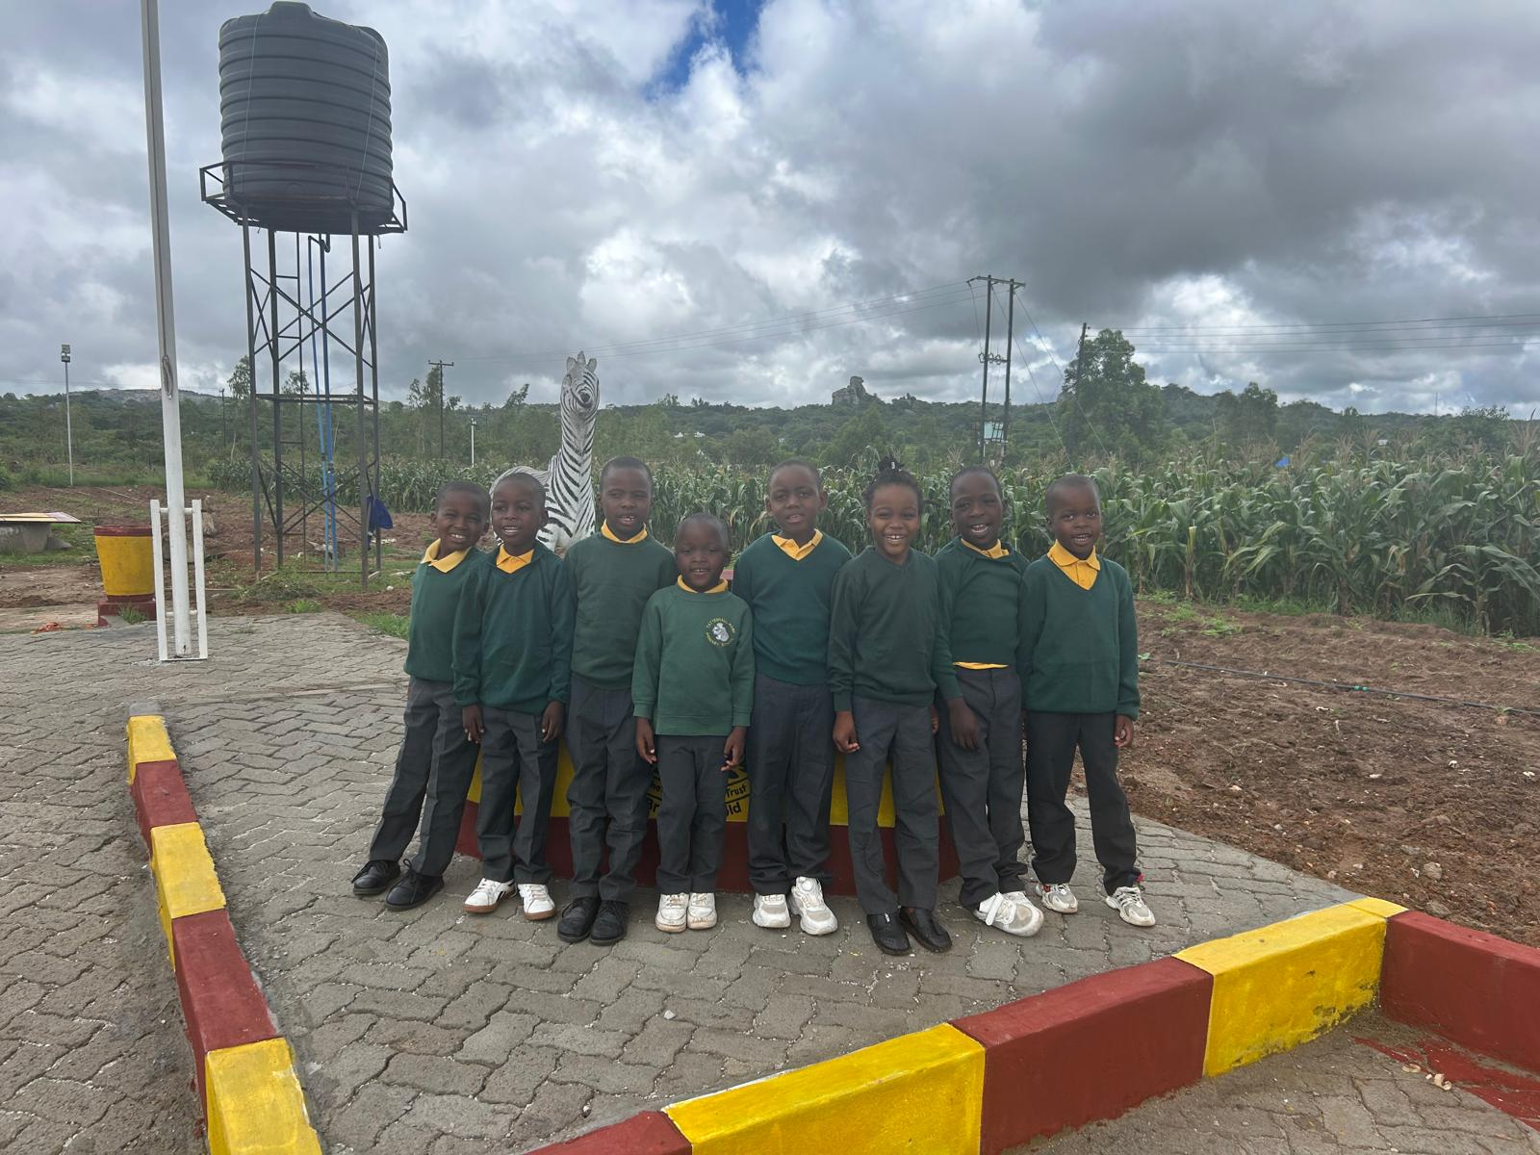
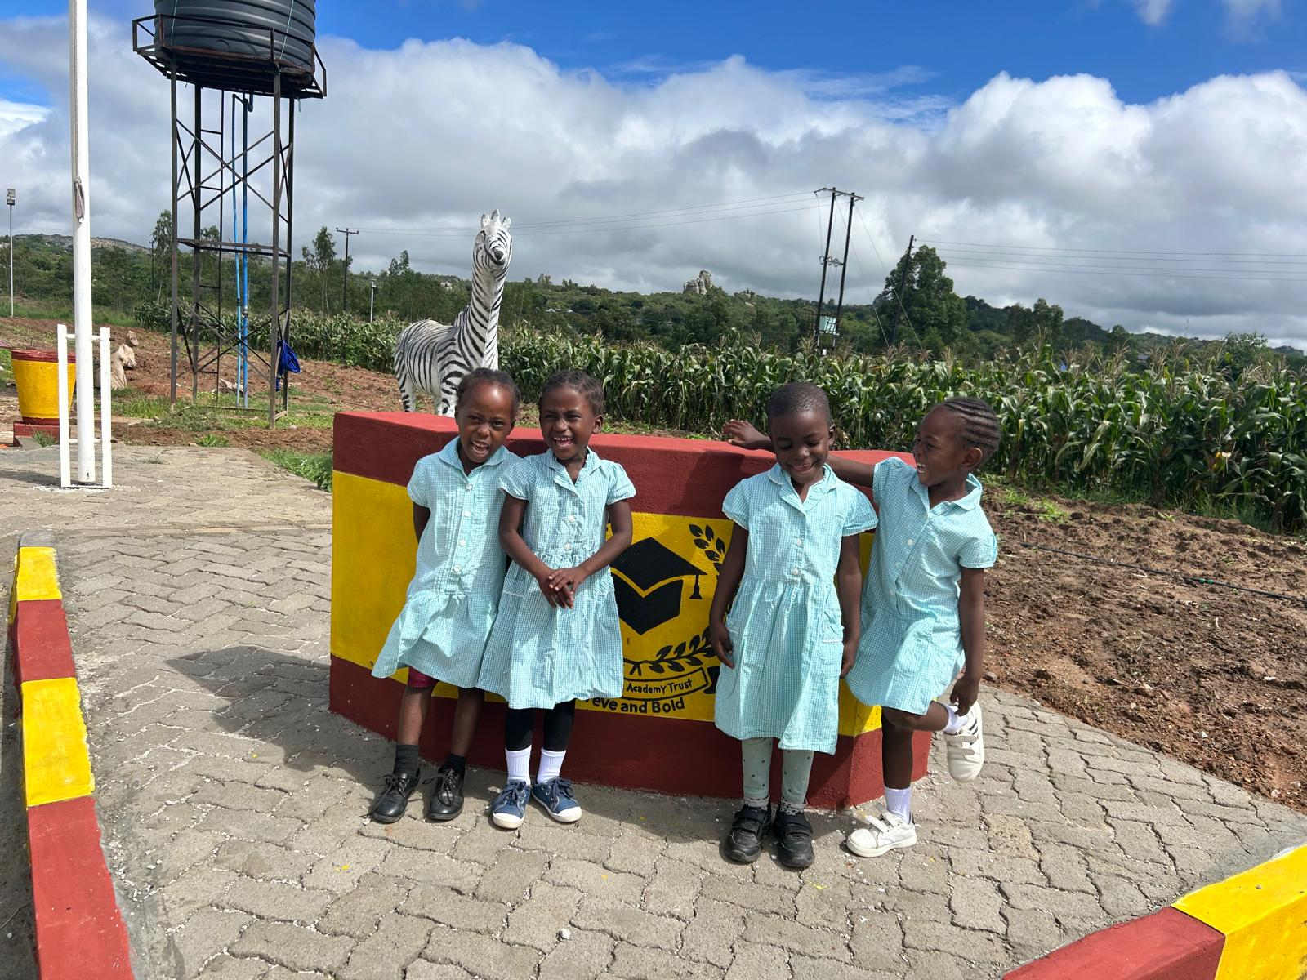
Thank you to Tattenhall Primary School for donating uniform
The pupils of Hera are proud to be wearing Tattenhall.

Slide 26
Message from Father Lameck
“I met the parents later today and they were all surprised with this special gift and they would like to thank Tattenhall Park School for their love, kindness and generosity. They feel blessed”

Slide 27
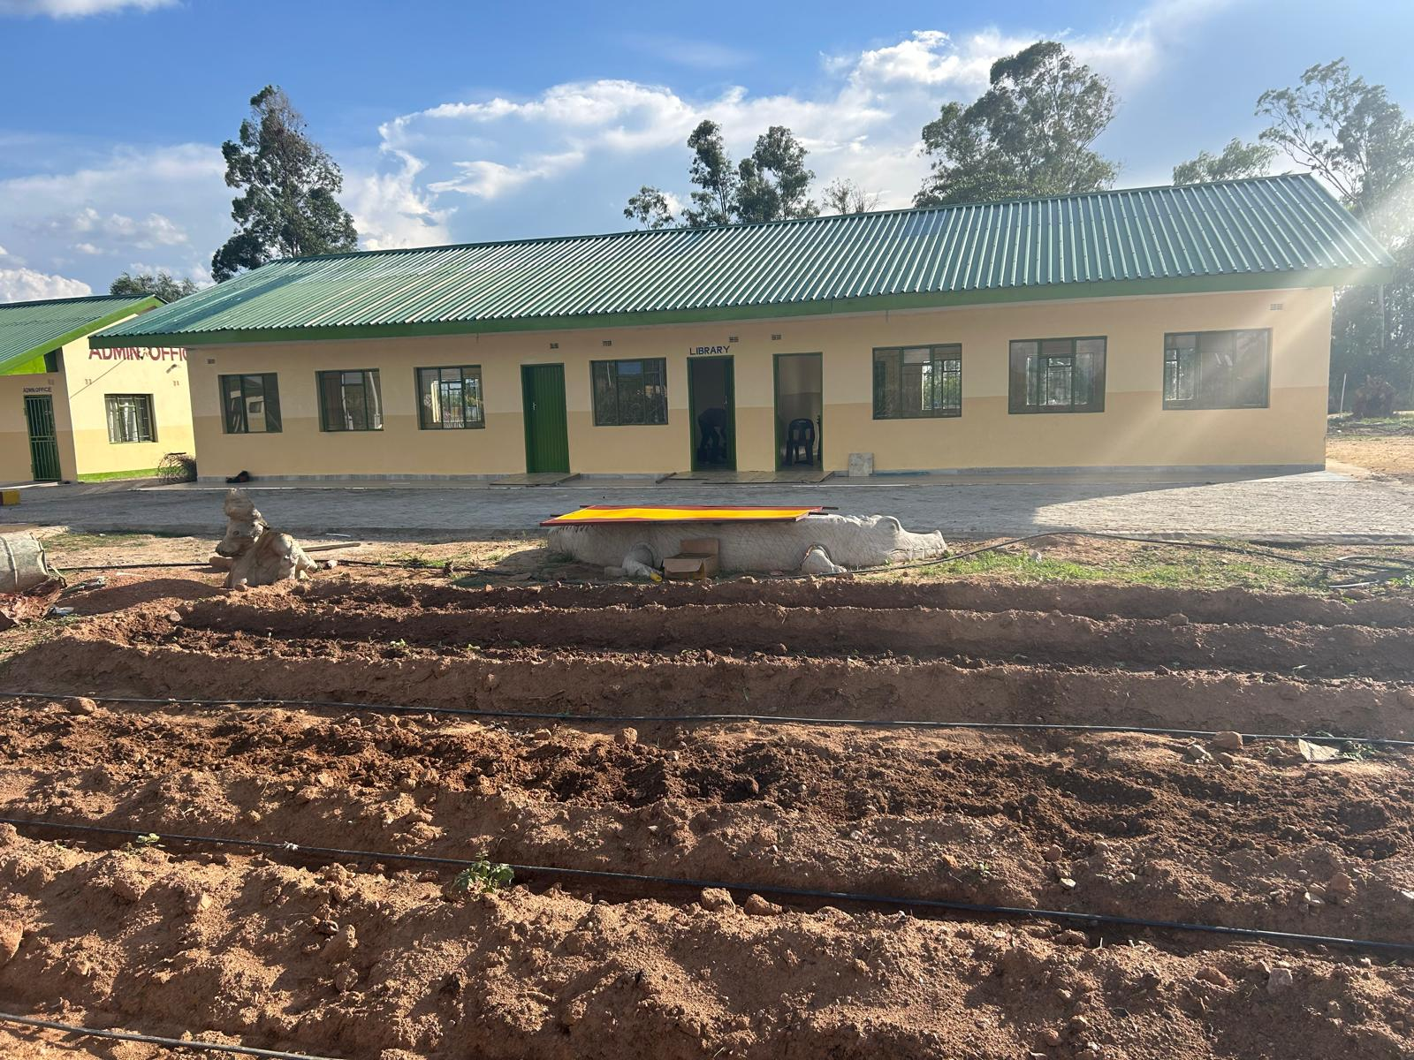
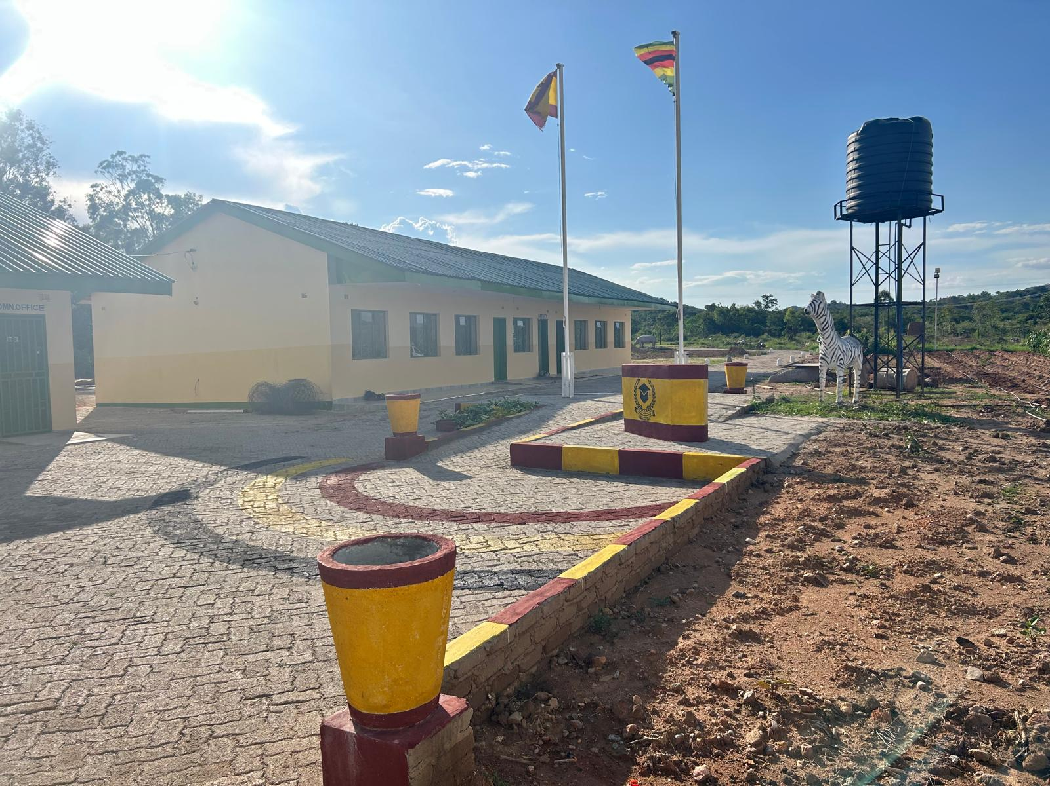
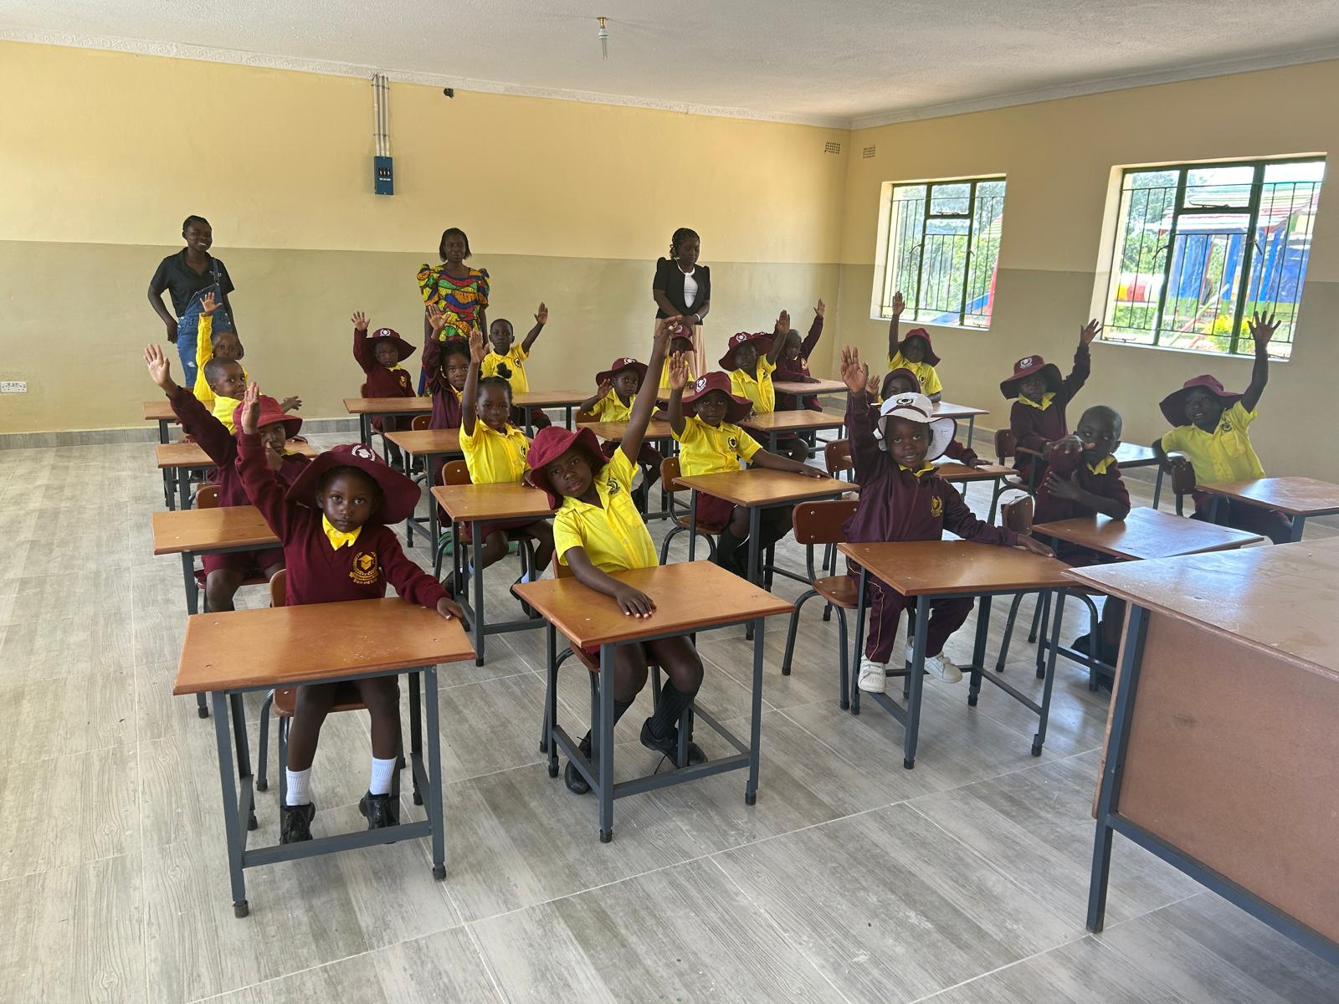
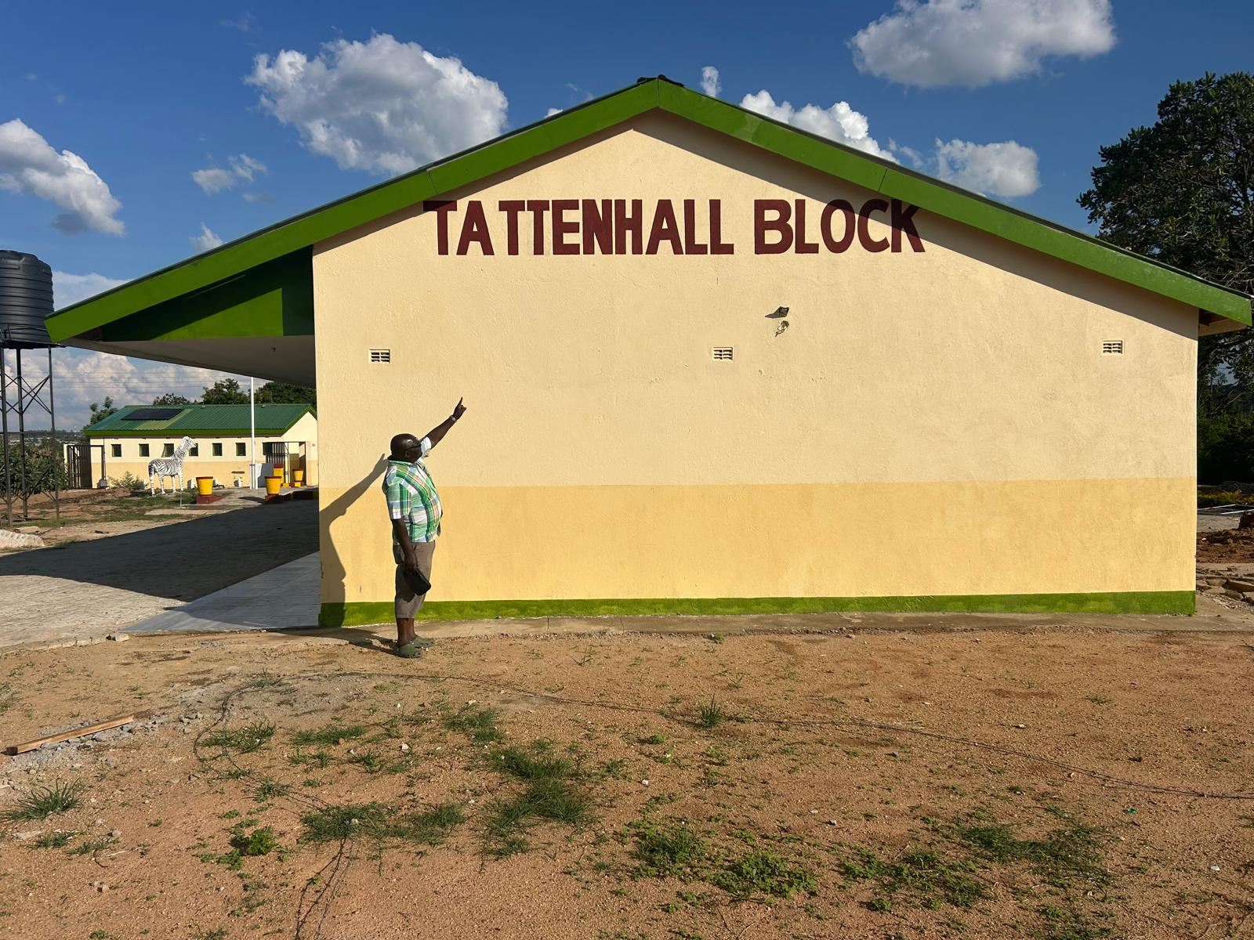
New Early Years Block
Now dedicated to Tattenhall

Slide 28
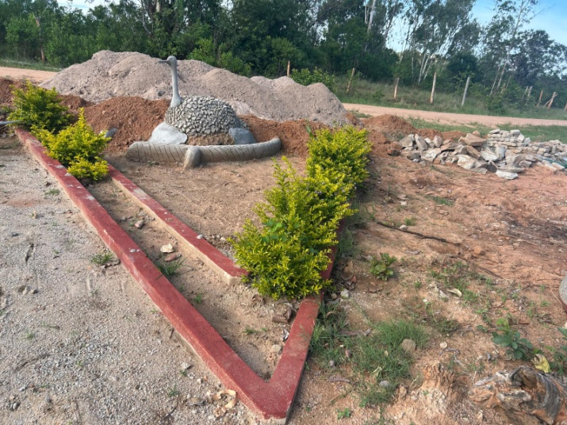
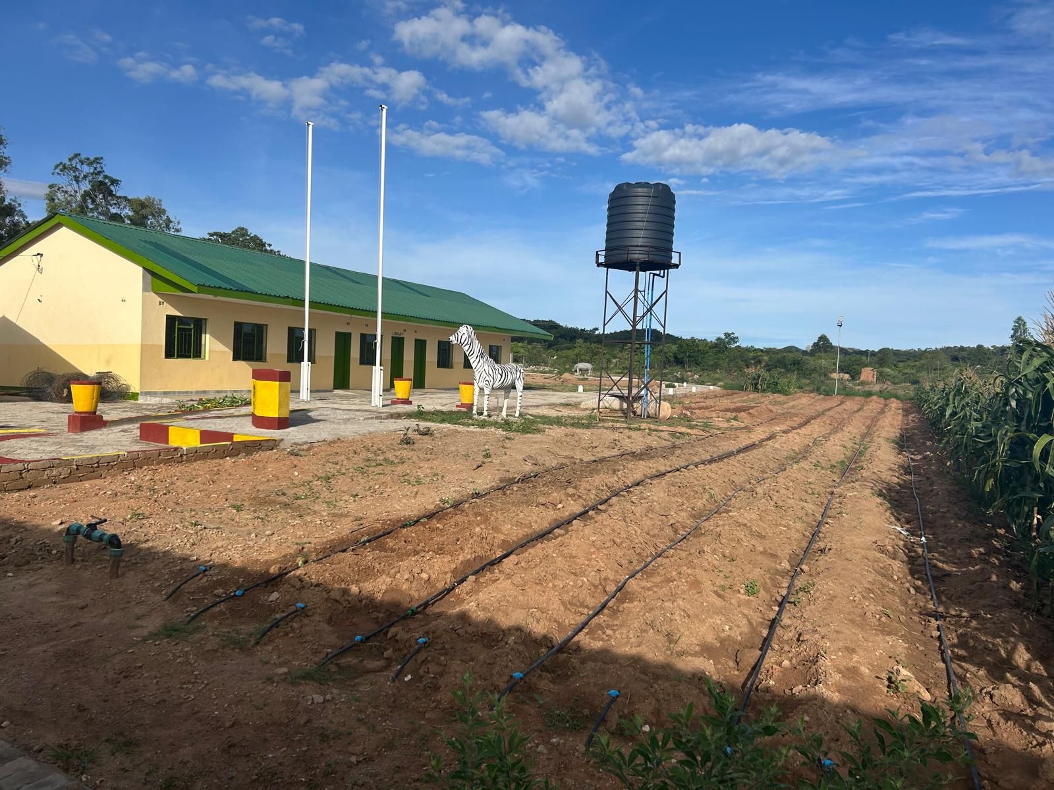
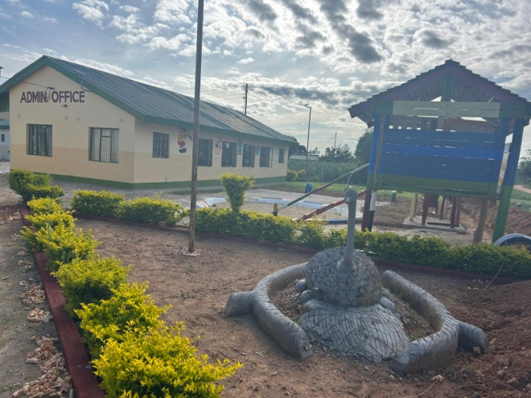
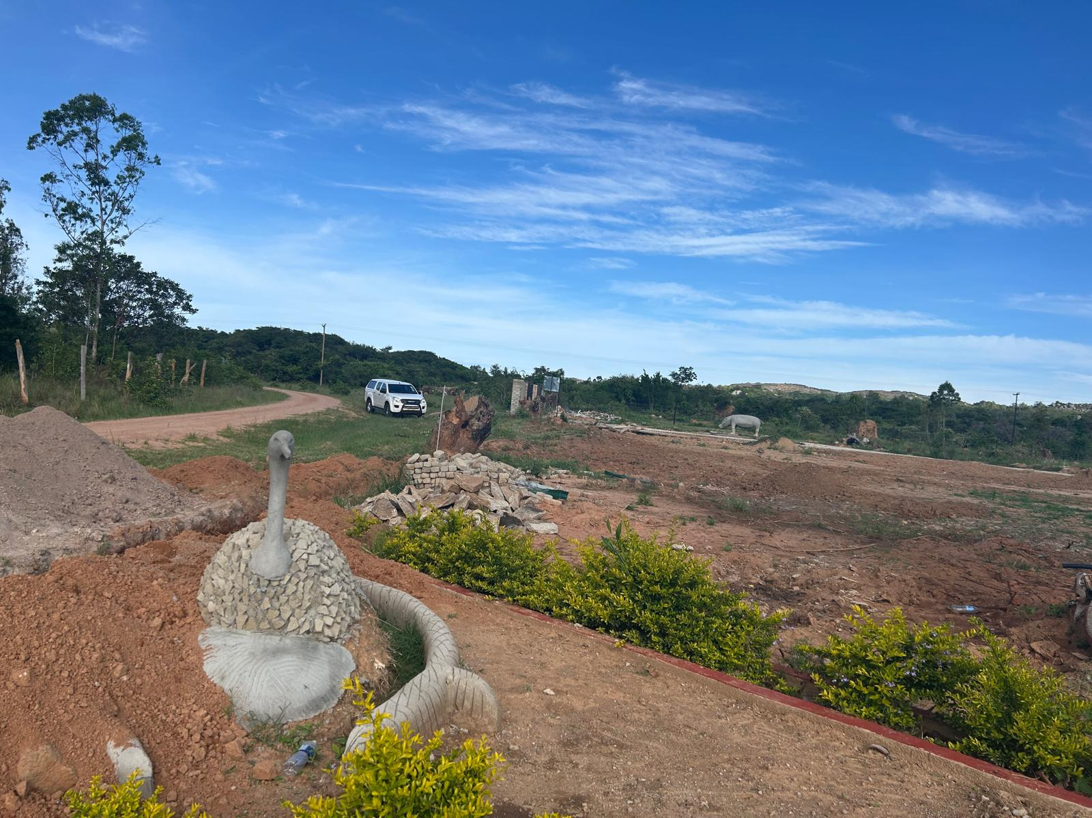
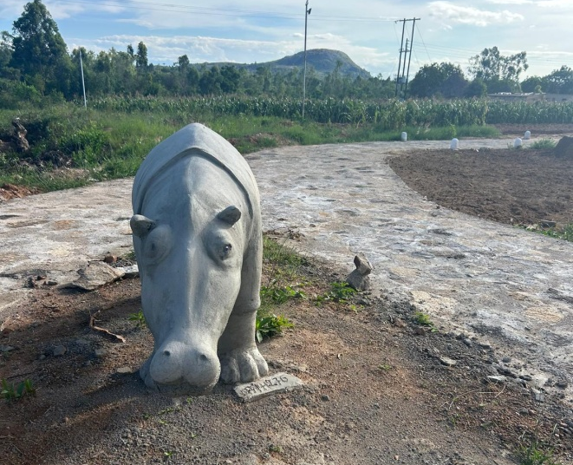
Landscaping Underway
Students passion for local wildlife reflected in the landscaping

Slide 29
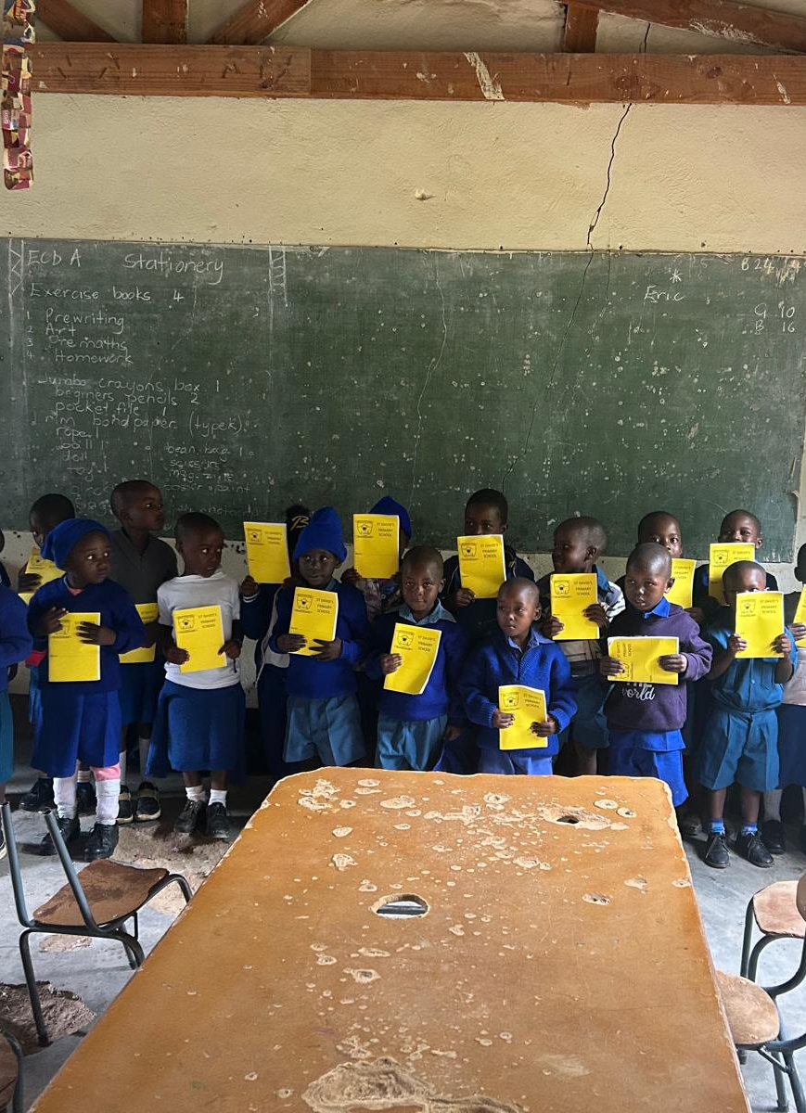
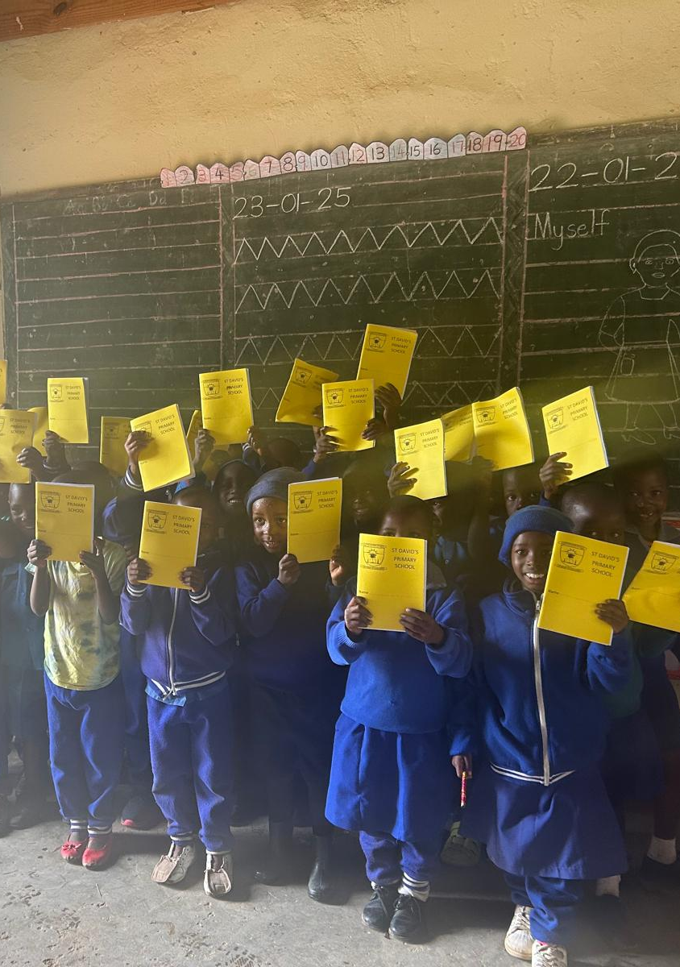
St Davids School
Distribution of new exercise books and supplies to the primary school.

Slide 30
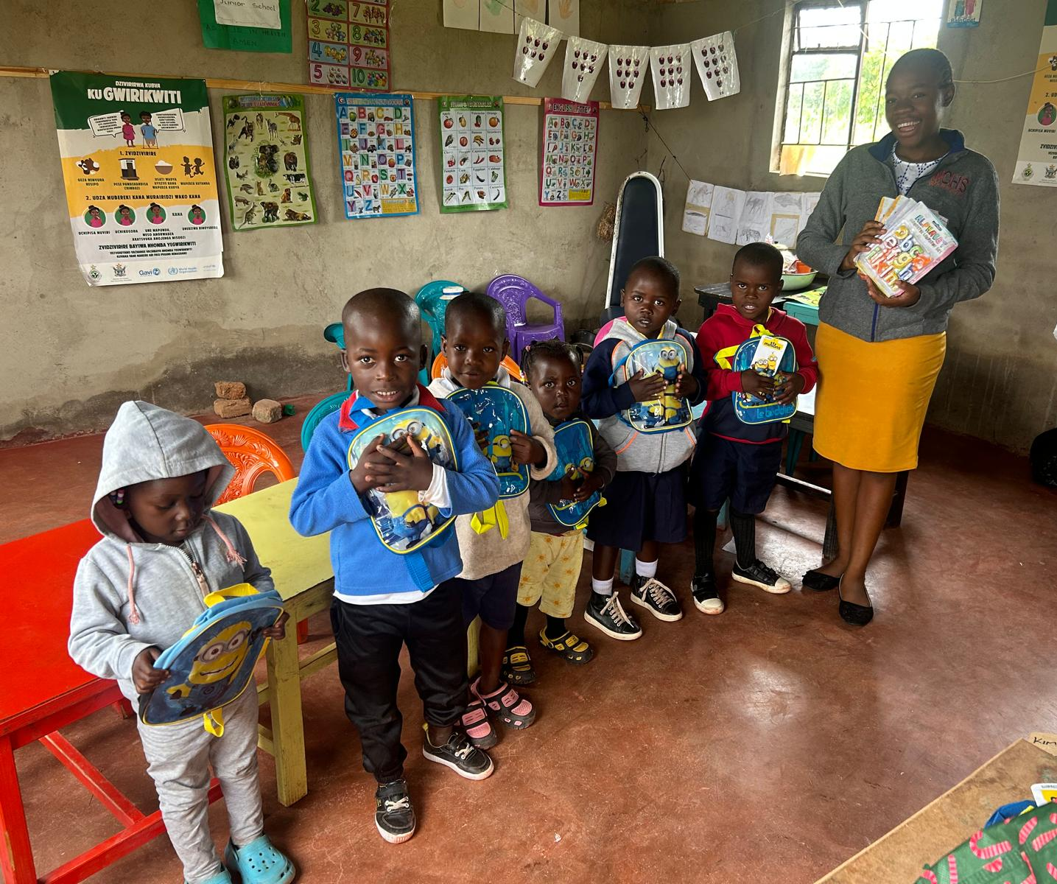
Early Years Unit
Delighted with new rucksacks

Slide 31
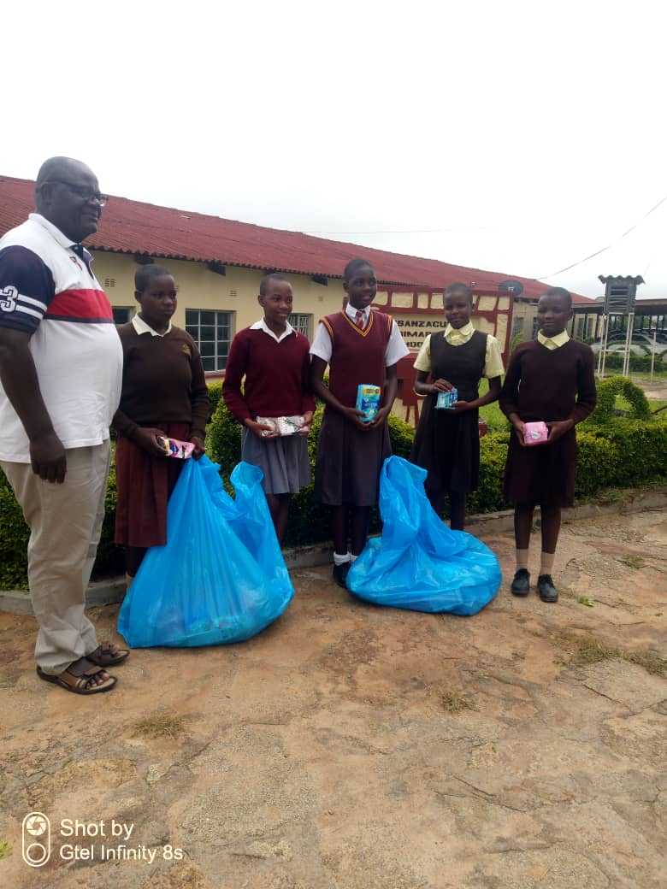
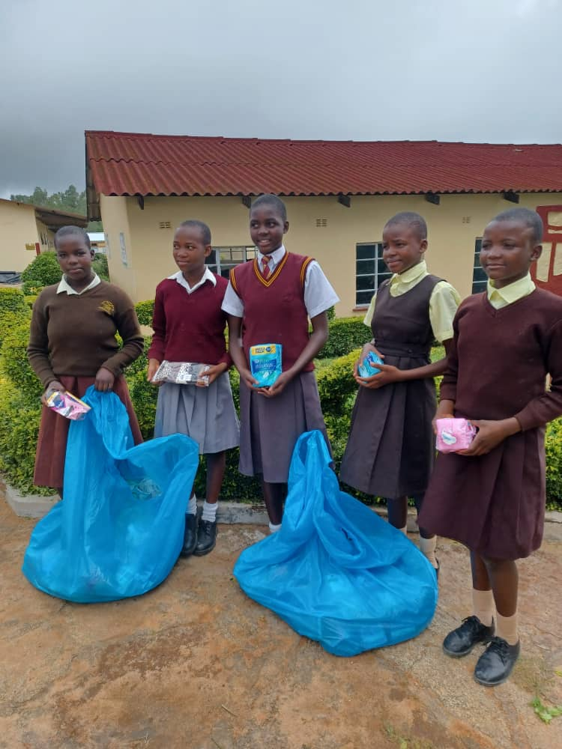
Tsanzaguru School
Thrilled with hygiene supplies.

Slide 32
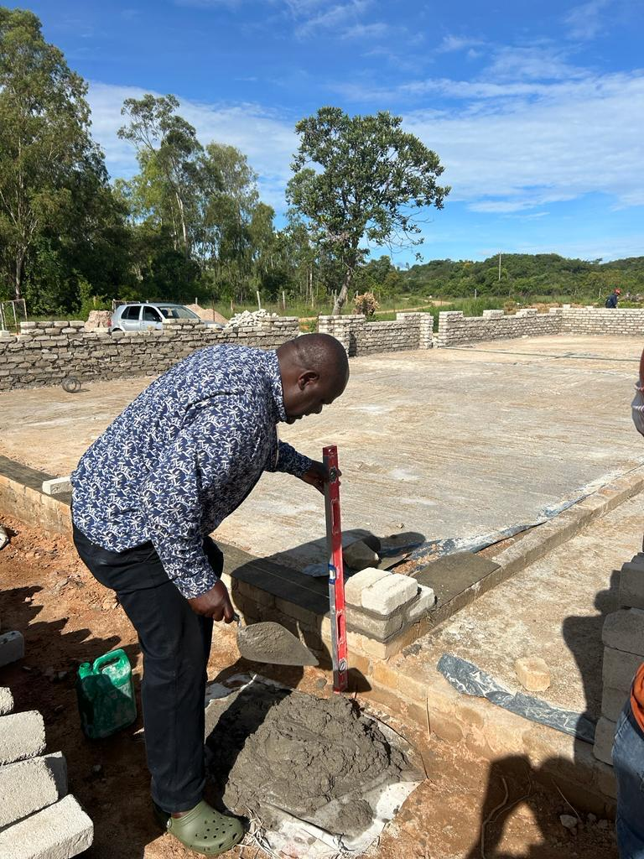
Thank you for all your hard work. Roll on more fundraising in 2025!

